Slide 1
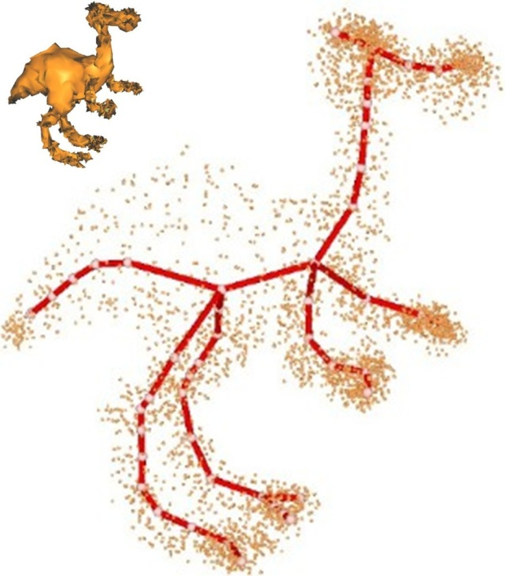



Point Cloud Skeletons via Laplacian-Based Contraction
Junjie Cao¹,
Andrea Tagliasacchi²,
Matt Olson²,
Hao Zhang²,
Zhixun Su¹
¹ Dalian University of Technology
² Simon Fraser University
Notes:
Thank you! We are going to discuss the extraction of curve-skeletons from
Unorganized point clouds via Laplacian-Based Contraction.
Graphics + usability + visualization

Slide 2
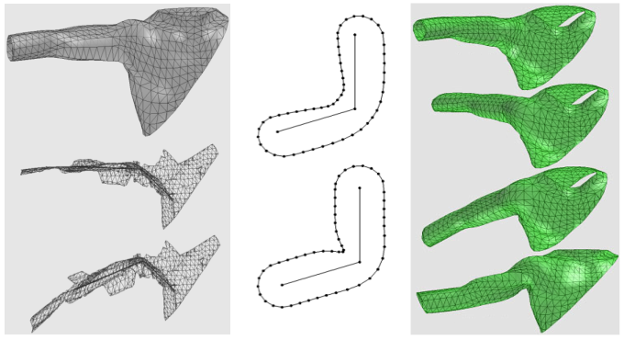
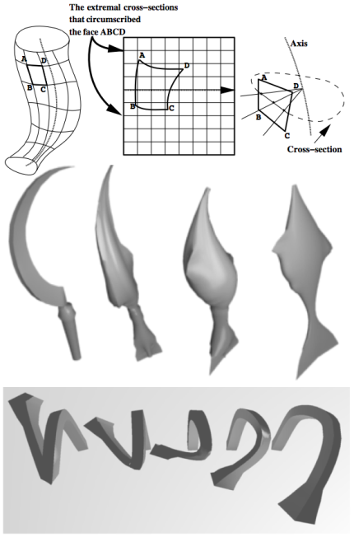
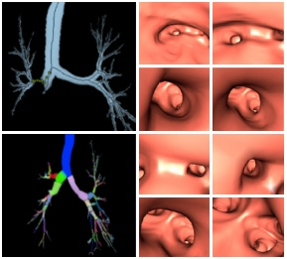
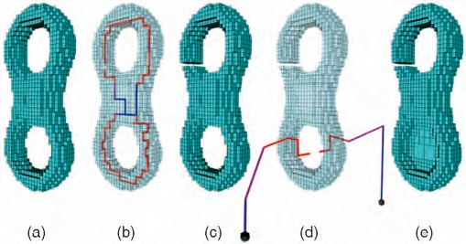
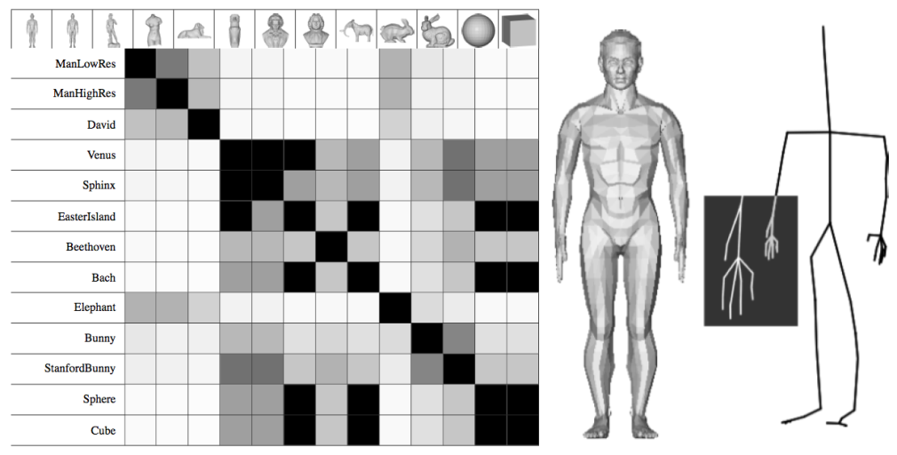
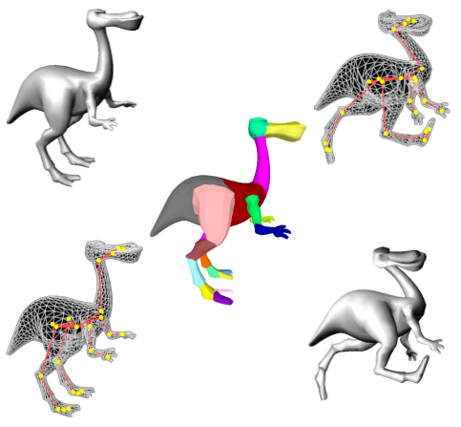
Curve skeletons and their applications
A 1D curve providing a compact representation of the shape [Cornea et al. 20 07]
Notes:
1D curve skeleton provides a compact representation of the shape. Examples of applications (that use a curve skeleton) include:
Deformation, Navigation, Segmentation, Shape editing, Shape correspondence,
Topology repair: Topology Repair of Solid Models Using Skeletons_tvcg07
etc.

Slide 3
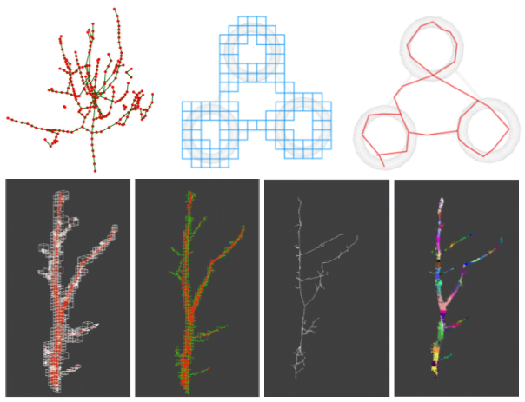
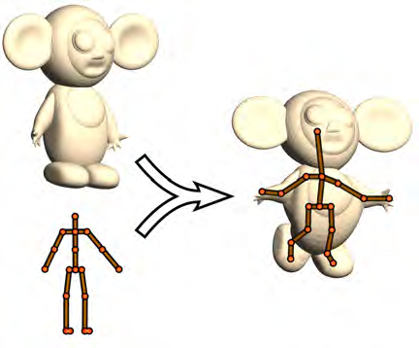
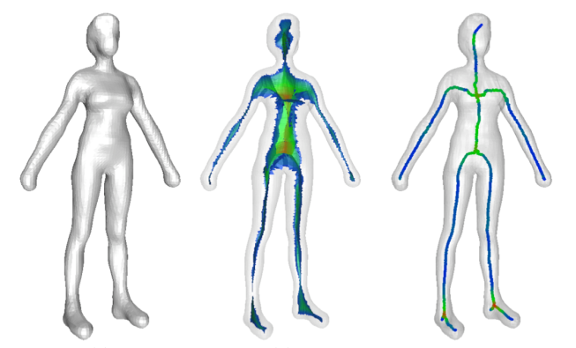
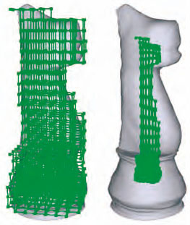
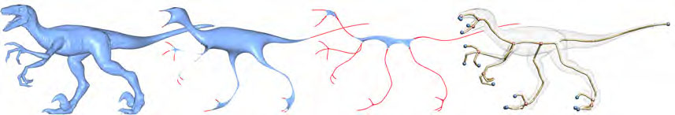
Existing curve skeleton extraction methods
Voxel thinning
Template skeleton adaption
Pruning medial axis
Volume contraction
Mesh contraction
[Bucksch and Lindenbergh 2008]
[Baran and Popovic 2007]
[Dey and Sun 2006]
[Wang and Lee 2008]
[Au et al. 2008]
Notes:
There are many techniques for curve skeleton extraction, such as:
Voxel thinning: : [Bucksch and Lindenbergh 2008] CAMPINO — A skeletonization method for point cloud processing
Automatic adaption of template skeleton: [Baran and Popovic 2007] Automatic Rigging and Animation of 3D Characters_tog07
Pruning the medial axis: [Dey and Sun 2006] Pruning the medial axis,(Medial geodesic function)
Volume contraction, [Wang and Lee 2008] Curve-Skeleton Extraction Using Iterative Least Square Optimization TVCG08
Mesh contraction, (Au, skeleton extraction by mesh contraction, SigA08).
Most of them, work for volumetric or triangulated representations, and operate on complete data.
However, most interesting models are first acquired in the form of point cloud data.

Slide 4
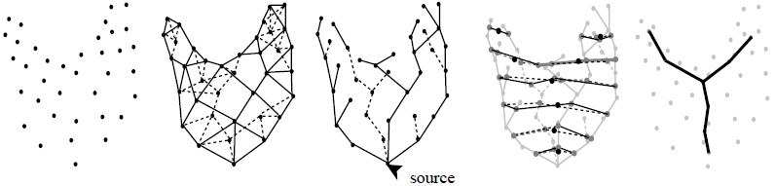
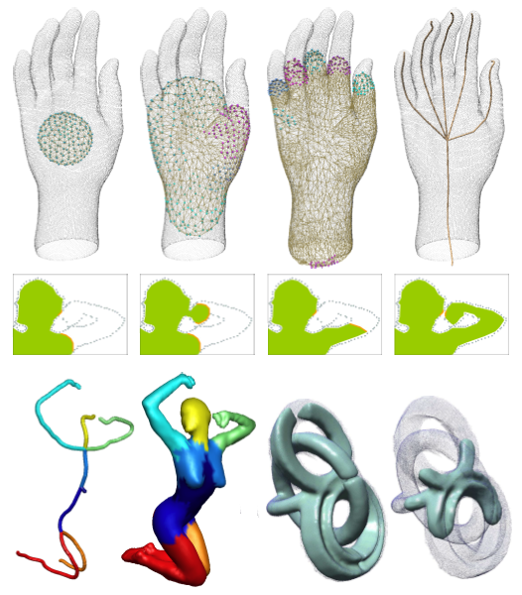
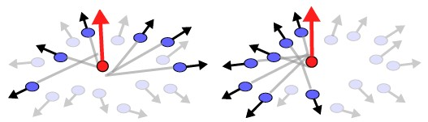
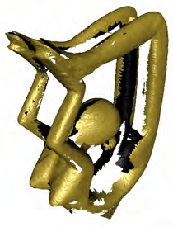
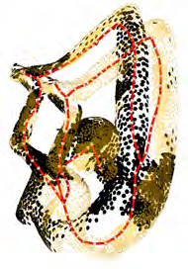
Existing curve skeleton extraction methods
Reeb graph
Geometry snake
Generalized rotational symmetry axis
[Verroust and Lazarus 2000]
[Sharf et al. 2007]
[Tagliasacchi et al. 2009]
Notes:
For point clouds skeleton extraction we have several alternatives:
Reeb Graph based method: [Verroust and Lazarus 2000], Extracting Skeletal Curves from 3D Scattered Data, vc00
Geometry snake-like method: [Sharf et al. 2007], deformable modes, for mesh and point cloud, EG07
Generalized rotationally symmetric analysis based method: [Tagliasacchi et al. 2009], The first to extract curve skeleton for PCD in the presentence of large amounts of missing data.
Here, we will present a new curve skeleton extraction method for point cloud models.

Slide 5
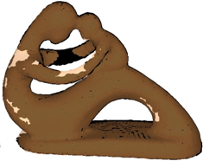
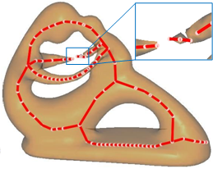
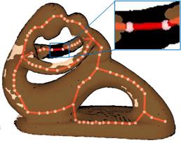
Is extracting skeleton directly from point cloud data necessary?
Missing data
Volume
?
Point cloud
Skeleton
Mesh
PCD with missing part
Poisson reconstruction and skeletonization by mesh contraction [Au et al. 2008]
Our method
Notes:
Given a point cloud, how could we get its curve skeleton?
Indeed, one may compute the curve skeleton of a point set by first performing a voxelization or surface reconstruction and then apply volumetric or mesh skeletonization.
It is well known that volumetric methods share the common drawbacks of potential loss of details and numerical instability caused by inappropriate discretization resolution.
And point cloud data acquired from 3D scanner are often not well-sampled and with missing part for self-occlusion and other acquisition hindrances. When the PCD contains large amounts of missing data, automatic surface reconstruction schemes tend to produce incorrect surface topology, which in turn, cause the extracted skeletons to be erroneous.
So we propose an algorithm to construct a curve skeleton directly on point cloud data, without voxelization the shape or explicit surface reconstruction.

Slide 6
Contributions
Directly on point cloud
No normal or any strong prior
Application of point cloud Laplacian
Skeleton-assisted topology-preserving reconstruction
Notes:
We extract the skeleton directly overcoming the significant obstacle in solving problems like: shape matching, retrieval, segmentation, or animation directly on PCD, without a costly and maybe error-prone reconstruction phase.
Our solution neither requires normal information or any strong shape prior on the input model.
We illustrate how Laplacian based processing is applicable to point clouds, extending the work in Au et al’s
Finally, we present a skeleton-assisted topology-preserving reconstruction algorithm (extending the finite element method of Sharf et al. [27])

Slide 7
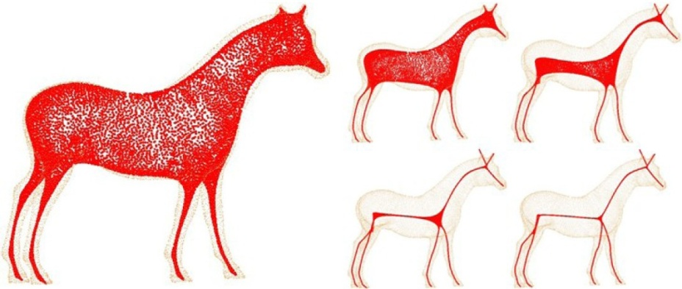
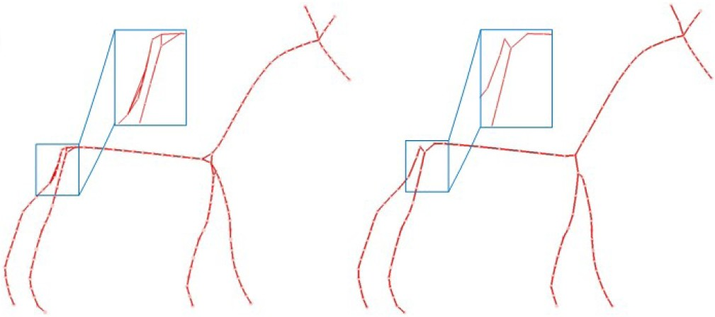
Outline
+
Geometry contraction
Topological thinning
Notes:
Given a point cloud, we first contract it to a zero-volume point set.
Next, we build a skeleton graph by sub-sampling and the contracted cloud and computing a restricted connectivity
We then contract edges of the skeleton graph iteratively to build a curve skeleton.

Slide 8
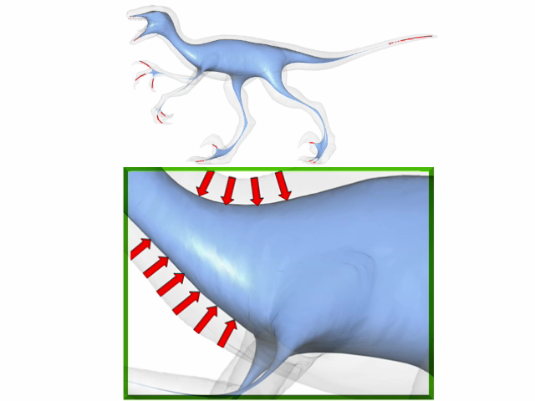

Geometry Contraction
Minimizing the quadratic energy iteratively:
Laplacian constraint weights
Position constraint weights
Contraction constraint
Attraction constraint
Notes:
The energy minimization is similar to Au’s approach, an iterative quadratic energy minimization:
The Laplacian contraction term removes geometry details along the normal directions.
An attraction term preserves the geometry of the shape by anchoring points
The challenge of this geometry contraction is the tuning of Laplacian constraint weights WL and the Position constraint weights WH
Correct tuning will result in a contraction which well approximates the original geometry of the shape.

Slide 9
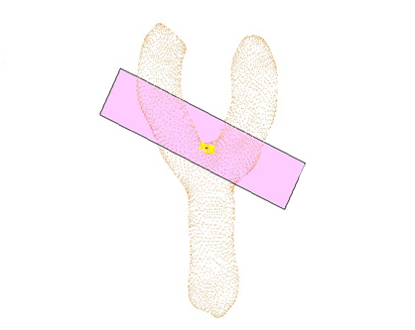
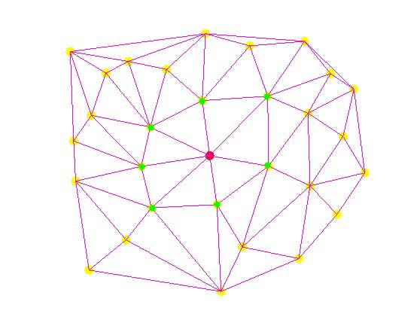
Laplacian construction for point cloud
Voronoi-Laplacian, PCD-Laplacian?
Planar Delaunay triangulation of points within a distance R
Assumption: point cloud is smooth enough and well sampled
KNN + 1-ring of local (planar) Delaunay triangulation
Keep the 1-ring during the contraction iterations
Cotangent weights
ε-sampling
(ε,δ)-sampling
Voronoi-Laplacian: C. Luo, I. Safa, and Y. Wang, “Approximating gradients for meshes and point clouds via diffusion metric”, Computer Graphics Forum, vol. 28, no. 5, pp. 1497–1508, 2009.
PCD-Laplacian: M. Belkin, J. Sun, and Y. Wang, “Constructing Laplace operator from point clouds in R^{d}”, in Proc. of ACM Symp. on Discrete Algorithms, pp. 1031–104, 2009.
Notes:
The most of important is to find proper Laplacian for the contraction purpose on PCD.
The two recently proposed Laplacian for PCD are not proper for the job.
They are similar, as both need to compute a planar Delaunay triangulation of the set of points within a distance R and then use the triangulation to define a weighting scheme. Since no automatic scheme for the choice of the scale parameter R is available, applying such techniques directly would be difficult, especially as we need to re-compute the Laplacian at every iteration.
We need to do the local triangulation only once and keep the 1-ring structure along the contraction iterations. Since after several contractions, lost of points crowded almost together make the estimation of local tangent plane and triangulation numerically unstable.
To mitigate these problems, we take a similar approach to Floater’s meshless parameterizaiton.
Use K nearest neighbor of a point P to estimate a tangent plane. Construct Laplacian via 1-ring of the Delaunay triangulation. Now we can use the famous cotangent weights Laplacian to contraction the PCD.

Slide 10
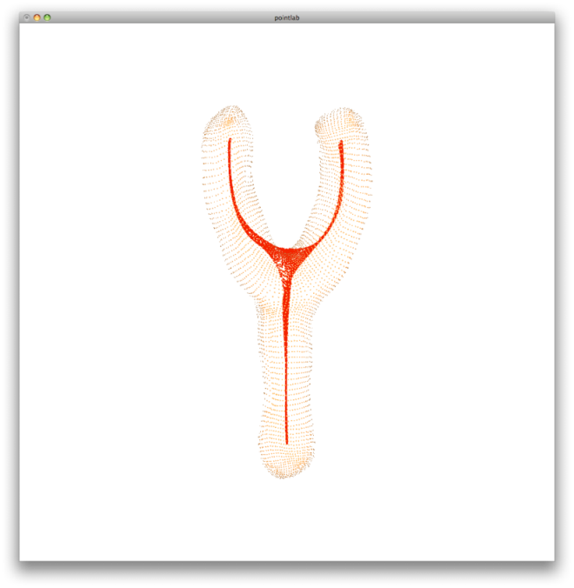
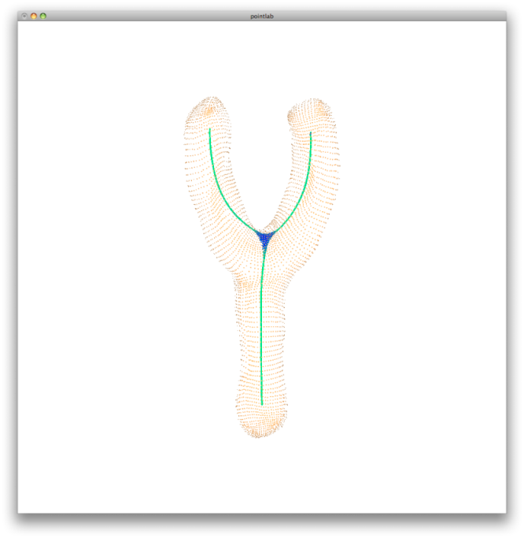
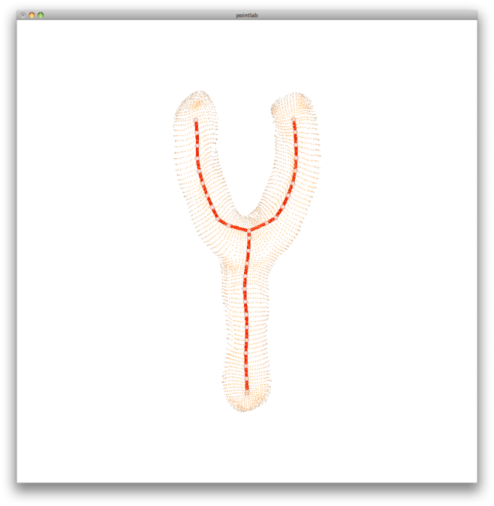
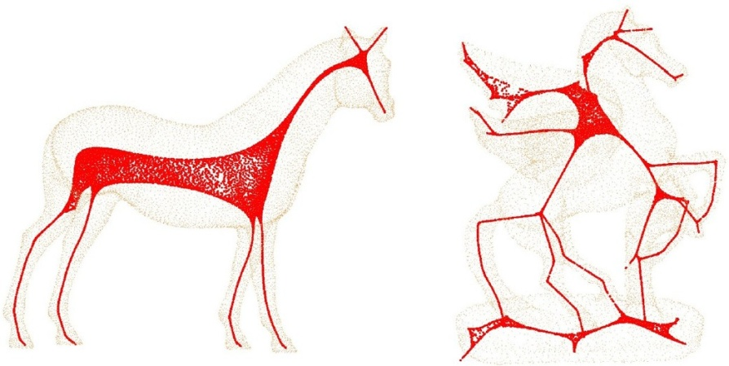
Topological thinning
[Shapira et al. 2008], [Tagliasacchi et al. 2009]
Previous approach: MLS projection (line thinning) + Joint identification
[Li et al. 2001]
Our approach: Building connectivity + Edge collapse
Notes:
NOTE: skim these notes down… you don’t want to take too long here..
Previous techniques for converting contracted points to curve skeleton, use moving least squares (MLS) projections and
Joint identification by PCA.
It delicates parameter tuning to handle a contracted shape with different local characteristics.
So the approach we take is building connectivity + edge contraction.
===============================================================================
, which is similar to progressive mesh
algorithms first presented in [Li et al. 2001].
[Shapira et al. 2008]: Consistent mesh partitioning and skeletonization using the shape diameter function
[Tagliasacchi et al. 2009]
[Li et al. 2001] “Decomposing polygon meshes for interactive applications”

Slide 11
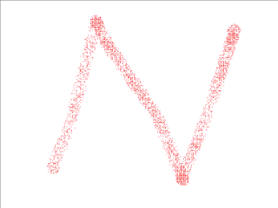
Topological thinning – Farthest point sampling
Sample contracted points using farthest-point sampling and a ball of radius r (r=0.02*diag(BBOX|P|) )
Notes:
We sample contracted points using farthest-point sampling and a ball of radius r (r=0.02 times the length of the longest diagonal of the model’s bounding box).

Slide 12
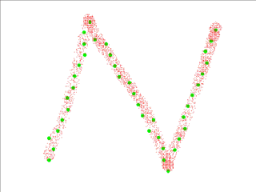
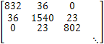
Topological thinning – Building connectivity
Sample contracted points using farthest-point sampling and a ball of radius r (r=0.02*diag(BBOX|P|) )
Connecting two samples if their associated points share common local 1-ring neighbors
i
i
j
j
Adjacency matrix
skeleton point
point on contracted point cloud
point on the original point cloud
Notes:
We use this strip-shaped point set to illustrate the process, since it is difficult to make the process clear using a well-contracted point set.

Slide 13
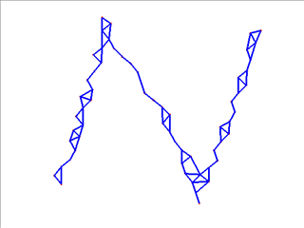
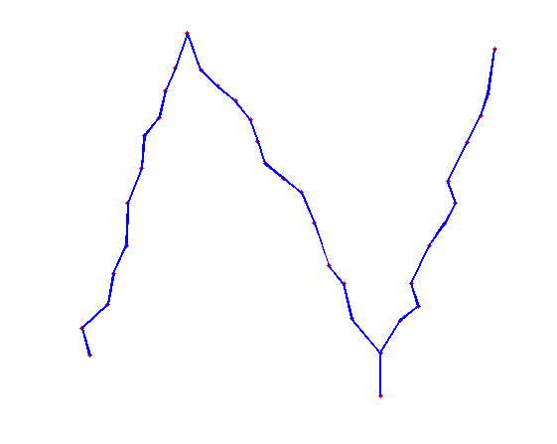
Topological thinning – Edge collapse
Sample contracted points using farthest-point sampling and a ball of radius r (r=0.02*diag(BBOX|P|) )
Connecting two samples if their associated points share common local 1-ring neighbors
Collapse unnecessary edges until no triangles exist
Notes:
Finally we post-process the graph by removing the remaining small cycles (measured by topological length) so that we obtain a true “curve” (1D, line representation)

Slide 14
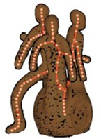
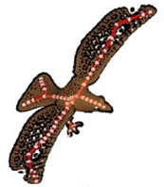
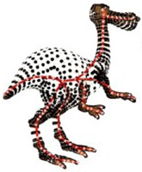
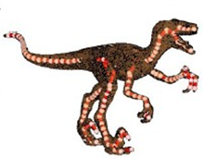
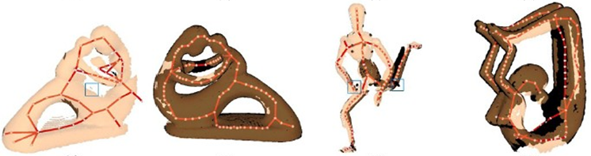
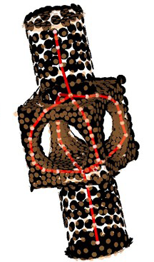
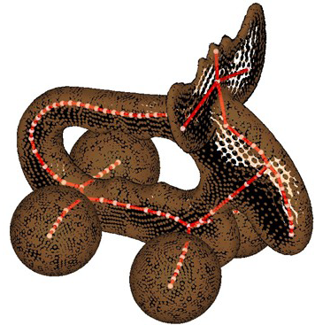
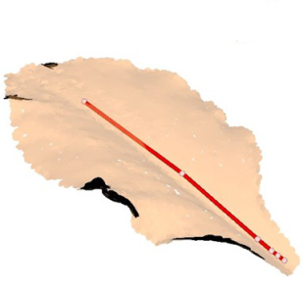
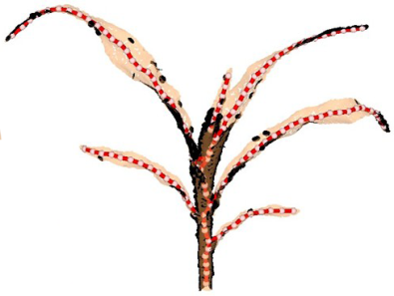
Gallery
Spherical region
Sheet-like region
Close-by structure
Missing data
Genus
Surfaces
with boundaries
Notes:
We now present several results from our algorithm.
We can properly identify the curve skeleton in spherical regions, as in Fig. 7(a), and sheet-like regions, as in Fig. (b).
The algorithm is able to deal with close-by structures, as the claws in Fig. 7(b), (c), and (d).
Our method also works well for surfaces with boundaries as shown in Fig. 7(i) and (j), and models with complex topology.
Our MATLAB implementation typically takes less than 2 minutes on a point cloud with 10K points.

Slide 15
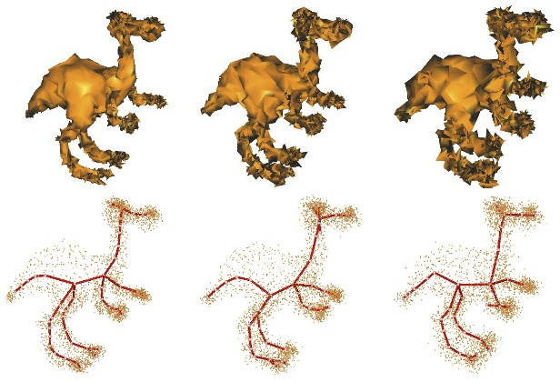
Insensitive to random noise
1%, 2% and 3% random noise
Notes:
1%, 2% and 3% random noise

Slide 16
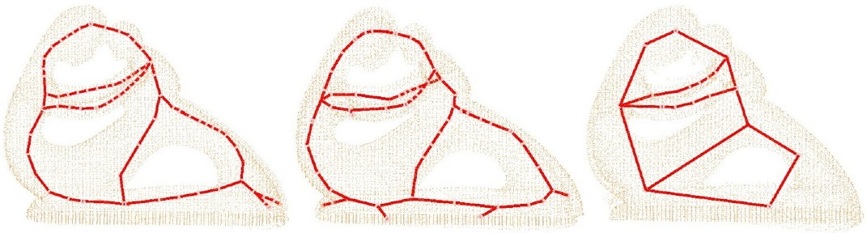
Insensitive to misalignment
0.5%, 1% and 1.5% misalignment noise
Notes:
0.5%, 1% and 1.5% misalignment noise

Slide 17
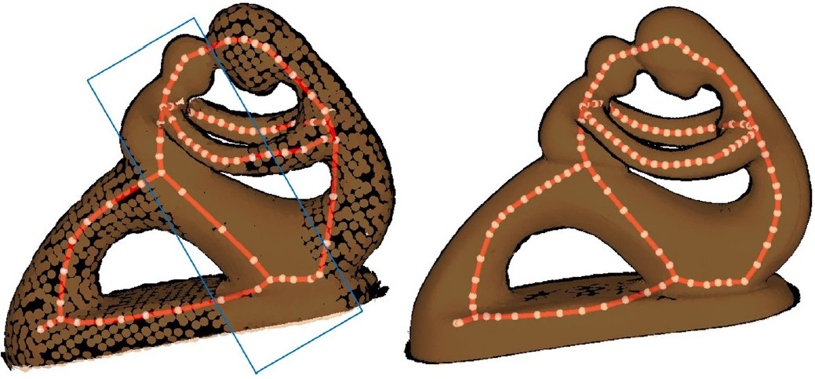
Insensitive to non-uniform sampling

Slide 18
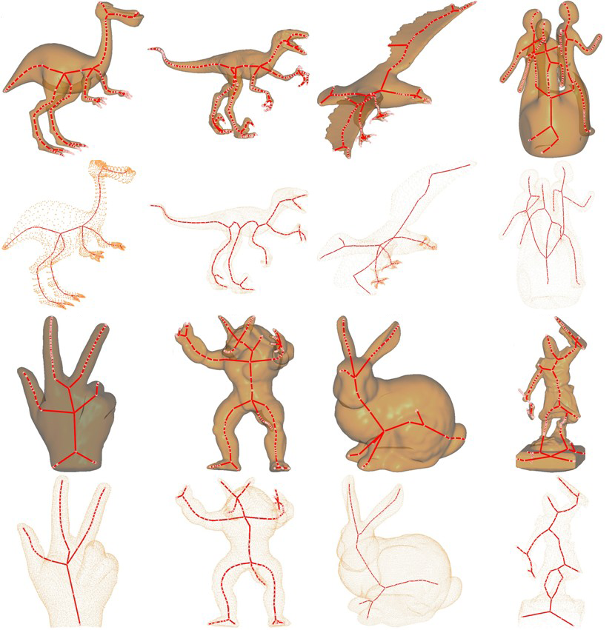
Comparison with [Au et al. 2008]
[Au et al. 2008]
Mesh
model
Our method
[Au et al. 2008]
Point
Cloud
model
Our method
Notes:
The first row are skeletons from mesh model via Au et al’s mesh contraction method,
The second row are skeletons of our point set contraction method for the same models.
The third row are Poisson reconstruction followed by mesh contraction.
the forth row are skeletons of applying our method directly on the raw scan point cloud data.
We can see that our method is designed for multiple discrete geometry data. And similar results are generated without an additional reconstruction process.

Slide 19
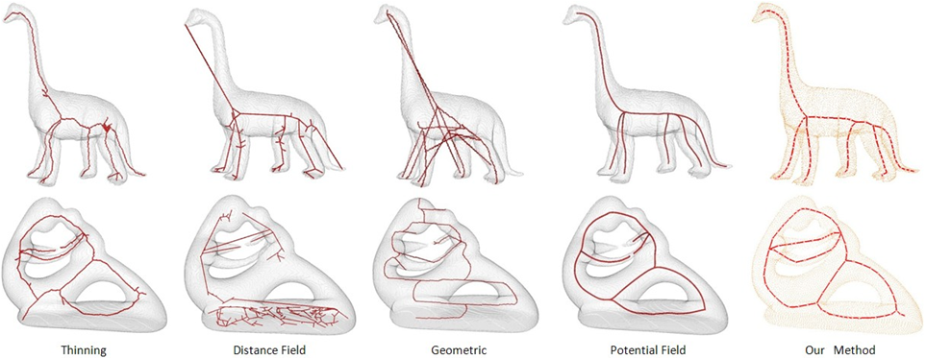
Comparison with four methods in [Cornea_tvcg07]
Notes:
All parameters are described in Cornea_tvcg07. All voxelizations are created by Corea’s VoxelizeOff (convert OFF file into voxelization) and MakeSolidVol (Fill voxelization, make it a solid voxelization).
The grid resolution was also same with the paper (chosen such that its largest dimension is 300 voxels and the aspect ratio of the object is maintained), except the dinosaur model (200x70x187).
The potential Field method is very slow. (9.22 minutes for the dinosaur. 200x70x187, and 287.8 minutes for fertility_4n_Poisson.300x224x109.vol)

Slide 20
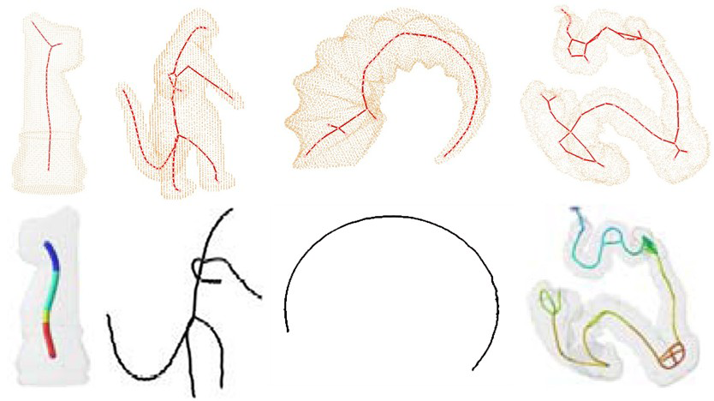
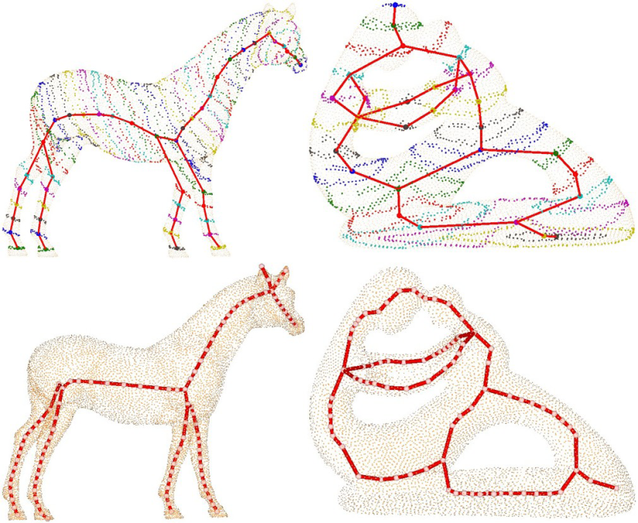

More comparisons
Comparison with Potential Field
Comparison with Reeb
Reeb
Deformable blob
ROSA
Our method
Mesh contraction
Notes:
Compare with volume based method – Potential Field, our method may keep more details.
We also compared our method with three famous point cloud skeleton extraction methods.
Comparing to Verroust et al. [5]’s Reeb graph like method: Our skeletons are smoother, keep more features.
Sharf et al. [4]’s Deformable blob, it need lost of parameter tuning and iterations to compute the result.
Compared to Tagliasacchi[9]’s generalized rotationally symmetric analysis method, our solution neither requires normal information or any strong prior on the input shape, and explicitly models joint structures.

Slide 21



Skeleton driven point cloud reconstruction
1. Reconstruction on a skeleton cross-section
2. Reconstruction along a skeleton branch
Notes:
In many situations, both surface reconstruction and skeleton extraction
automatically from the cloud is unsatisfactory both in terms of geometry and topology.
Nevertheless, curve skeletons are more efficient structure for topology and geometry editing than meshes with thousands of vertices and faces.
Thus, we allow the user to refine the location of skeletal nodes and modify the topology of the skeleton graph, to obtain a refined skeleton.
Based on the refined skeleton, we strive to compute the signed distance field of the shape, so that its surface
can be extracted by zero-level-set iso-surfacing.

Slide 22

Skeleton driven point cloud reconstruction

Slide 23

Limitations and future work
Improve neighborhood construction
Handle close-by structures
Use the curve skeleton to repair the point clouds directly

Slide 24
Acknowledgements
Anonymous Reviewers
AIM@SHAPE
NSFC (No. 60673006 and No. U0935004)
NSERC (No. 611370)
Notes:
At end, we’ll thank anonymous reviewers for their useful comments; shape repository for free models; and the organizations listed for their generous support.
24

